Slide 1
BRITISH AIRWAYS FORAGE PROGRAM
Behavioral analysis of customers

Slide 2
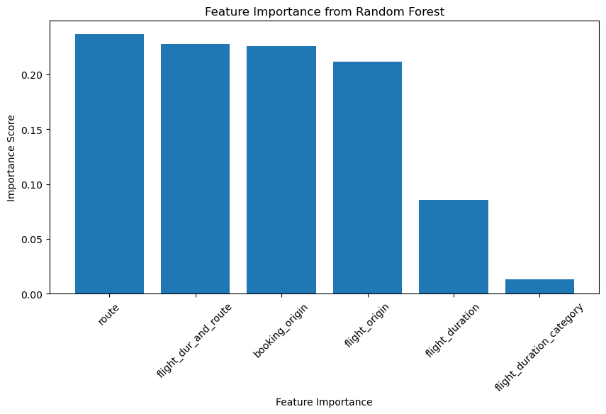
KEY INSIGHTS
After creating new features and analyzing the FIS as seen in the figure, two different RF models were trained with the results as follows:
Model 1 (SMOTE)
Precision: 0.8452
AUC: 0.7589
Model 2 (NO SMOTE)
Accuracy: 0.7362
AUC: 0.7469
The model without SMOTE is better for overall predictive performance while the model with SMOTE is still useful If the goal is to correctly predict more "1" cases (booking completions) as smote improved the recall. The Models can further be improved upon with more feature engineering
Wors that appeared the most in the user reviews

